Slide 1
ACADEMIC WORKLOAD AND TIME MANAGEMENT Nimra Amer 21L-5609 Muhammad Hassan Khalid 21L-5692 Muhammad Hamza 21L-5636 Muhammad Ahmad 21L-5617

Slide 2
OUTLINE
Main Challenges Identified
Student In-Depth Responses
Research Study
Analysis of Findings
Strategies to Overcome Challenges
Conclusion

Slide 3

Our research focus was centered on the Asian region.

Slide 4
Challenges
Heavy Workload
Mental Health Impact
Uneven Workload Distribution
1
3
5
2
4
6
Time Management and Delays in Work
Balancing Part-Time Work
Satisfaction with Academic Support

Slide 5

Student In-Depth Responses

Slide 6
Heavy Workload

Slide 7

Research conducted by scholars at "The College of Science and Technology, Royal University of Bhutan."
Student dissatisfaction with academic workload.
Major contributor to declining academic performance.
Discontentment associated with decreased overall grades.

Slide 8
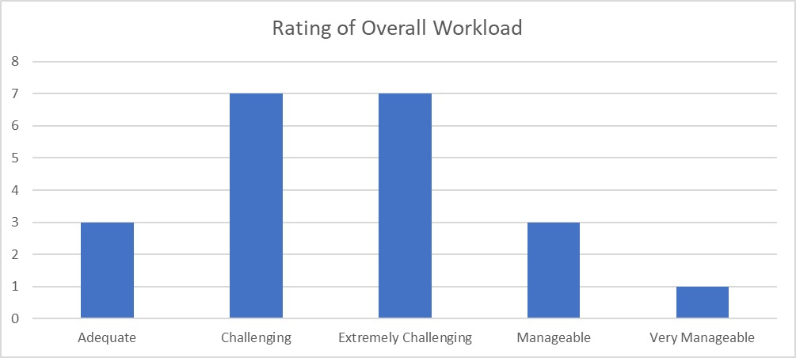
Findings at FAST University
Many students struggled with managing their academic workload due to its time-consuming nature.

Slide 9
Time Management and Delays in Work

Slide 10

Findings from "A Survey on Time Management among Students of Higher Education" by Saveetha Institute of Medical and Technical Sciences, Chennai, Tamil Nadu.
Neutral stance on time management.
Work delayed due to tendencies toward procrastination and laziness.

Slide 11
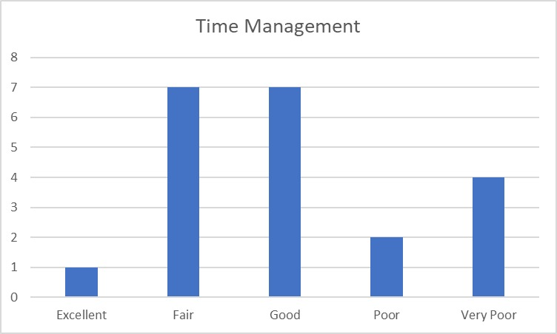
Findings at FAST University
Overall, the students are satisfied with their time management.
Pattern of procrastination and delayed submission of assignments and homework.

Slide 12
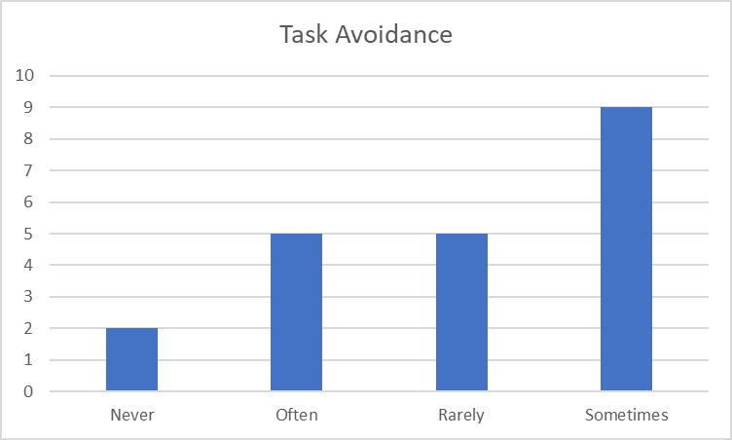
SOME MORE STATISTICS

Slide 13
Balancing Part-Time Work

Slide 14

Survey questions from "The Effect of Part-Time Jobs on University Students' Academic Achievement" by teachers at "Virtual University, Pakistan."
Students struggle to balance part-time jobs with studies, negatively impacting their grades.

Slide 15
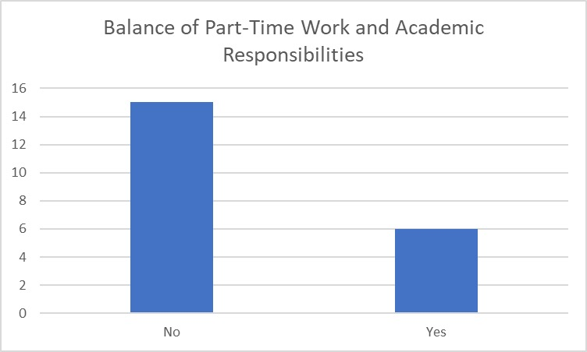
Findings at FAST University
MS students commonly have part-time jobs.
MS students find academic stress challenging, affecting their work-life balance.

Slide 16
Uneven Workload Distribution

Slide 17


Research conducted by the "Karachi Institute of Science and Technology, Pakistan" and "The University of Science and Technology, China."
Results: 44.5% of students strongly agree, and 36% agree that the workload is unevenly distributed among courses.

Slide 18
Findings at FAST University
Workloads are uneven, making it challenging to allocate equal attention to subjects.
Uneven workloads can lead to neglect of subjects with lighter workloads.

Slide 19
Satisfaction with Academic Support

Slide 20


Survey questions from professors in Malaysia and Pakistan.
Results indicate student dissatisfaction with the academic support provided by the university.

Slide 21
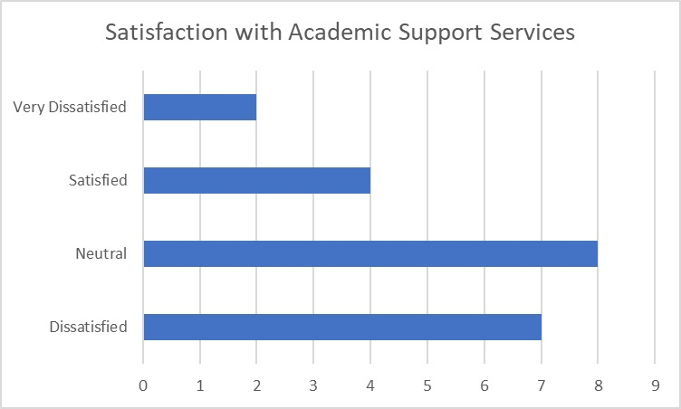
Findings at FAST University
Most students express a neutral sentiment about academic staff support.
A minority of students are highly dissatisfied with academic support.

Slide 22
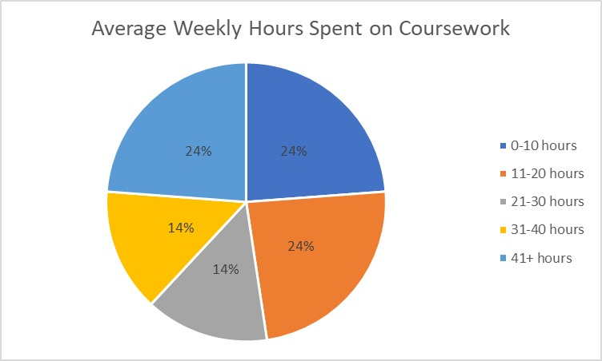
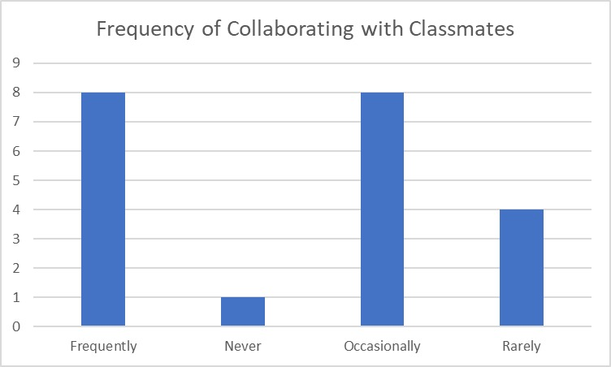
SOME MORE STATISTICS

Slide 23

Strategies to Overcome Challenges
Academic Advising
Time Management Workshops
Support for Part-Time Work
Communication and Feedback
Workload Transparency
Regular Surveys And Assignments

Slide 24
Conclusion
Prompt addressing of discussed challenges is important.
Even when only a minority of students face specific challenges, their academic future should not be overlooked.
Potential to greatly enhance the academic experience and overall learning environment.

Slide 25
Research Links
https://files.eric.ed.gov/fulltext/EJ1328924.pdf
https://bbrc.in/a-survey-on-time-management-among-students-of-higher-education/
https://files.eric.ed.gov/fulltext/EJ1262540.pdf
https://ojs.ual.es/ojs/index.php/eea/article/view/6293
https://final-version-of-article-166-fatima-saddique.pdf

Slide 26

Thanks!

